Slide 1
Project 3 - Machine Learning
Predicting Churn -- Telecom Subscriber Dataset
Presented by:
Ralph Watson-Quartey
Pema Yangzom
Geo Mirador
King Nsiah

Slide 2
Introduction
We present a telecommunications subscriber dataset. The dataset contains information about 6,000 subscribers. The features of the telecom subscriber dataset include: demographics, subscribed services, payment methods, amount of payments, etc.
The task is to analyze the dataset and predict whether a subscriber will churn or not churn based on the features.

Slide 3
Introduction Continued
Our work include the following items:
Project Goal
Import and Preprocessing of the data
Build classification algorithm based models for predictions
Comparison of the accuracy of the models built

Slide 4
Project Goal
The goal of the project is to explore the dataset (telecom subscribers) and build predictive models for Churn.
Churn is when a subscriber leaves the service and vice versa.

Slide 5
Preprocessing of dataset
Perform ETL
Remove non relevant features. Eg. CustomerID
Split dataset into independent variables and dependent variables
Encode data into numerical features
Drop redundant features after data encoding
6. Divide data into training and testing sets
7. Create a StandardScaler() model and fit it to training data.
8. Transform the training and testing data by using the X_scaler and y_scaler models
9. Perform Principal Component analysis on the X variables (independent variables)

Slide 6
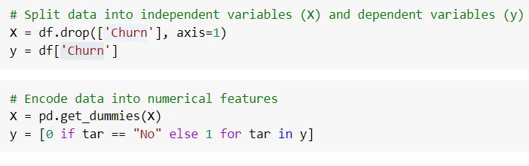

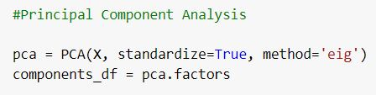
Preprocessing of dataset -- Continued
Encoding data into numerical features & Principal Component Analysis

Slide 7
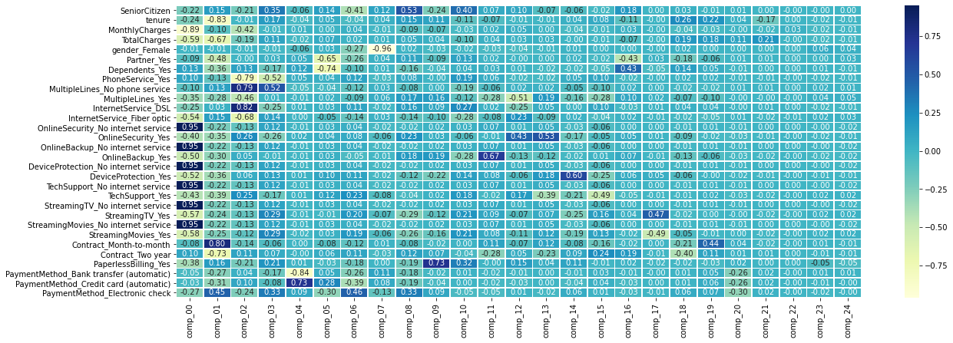
Preprocessing of dataset -- Features vs Principal Components correlation matrix

Slide 8
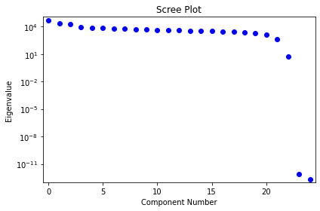
Preprocessing of dataset -- Scree Plot
This graph is a visualization of the scree plot used in deciding the components to truncate after performing PCA

Slide 9
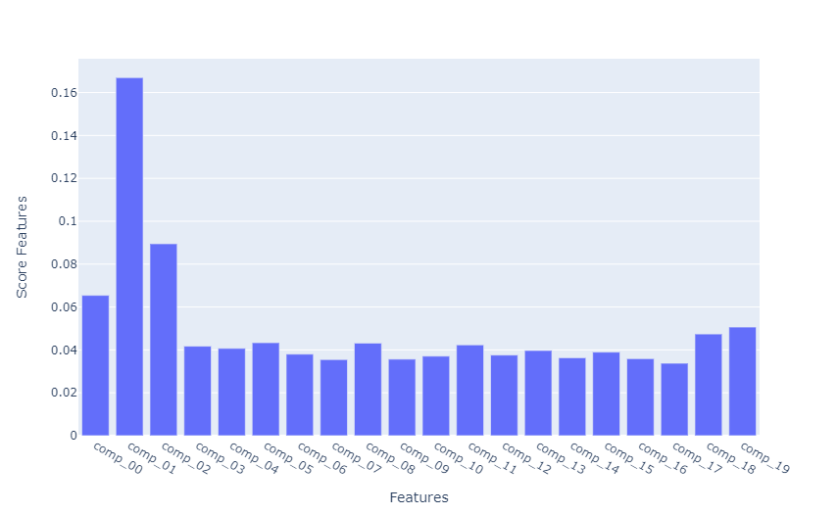
Preprocessing of dataset -- (Visualizing feature importance after PCA)
Feature importance distribution after PCA was performed and the redundant features truncated using the scree plot rule.

Slide 10
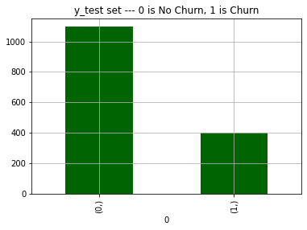
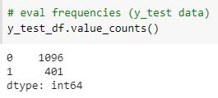
Visualizing “Churn” to “No Churn” ratio of y_test data
Visualizing y_test distribution for “Churn” and “No Churn” before training and testing of models.
0 represents No for “No Churn”
1 represents Yes for “Churn”

Slide 11
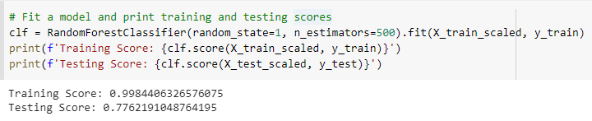
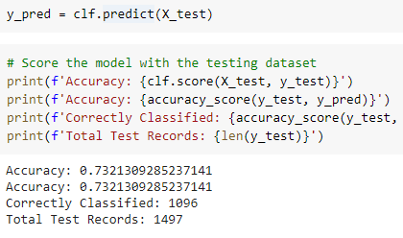
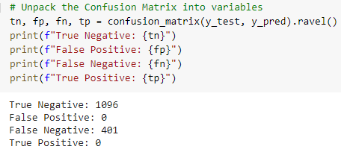
Building Model - Random Forest
Fitting and training the model and printing out the scores
Predicting(Churn or No Churn) using the test set
Confusion Matrix Figures

Slide 12
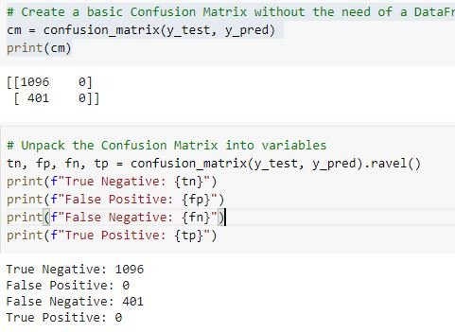
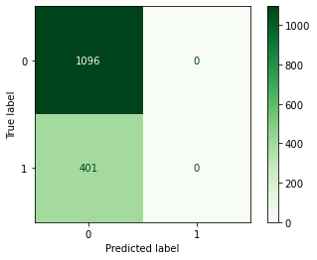
Random Forest Prediction Results (Confusion Matrix)

Slide 13
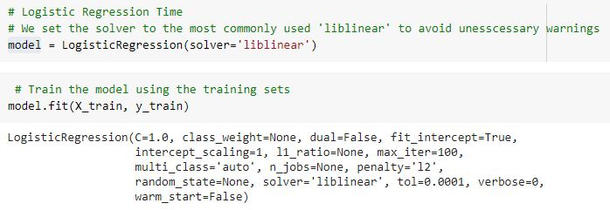
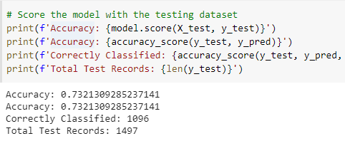
Building Model - Logistic Regression
Fitting and training the model and printing out the scores

Slide 14
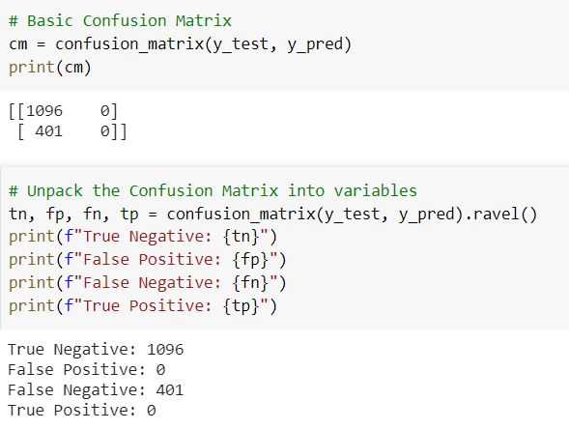
Logistic Regression Prediction Results (Confusion Matrix)

Slide 15
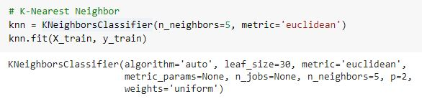
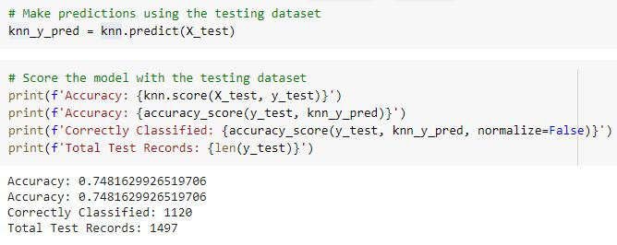
Building Model - K-Nearest Neighbor
Fitting and training the model and printing out the scores

Slide 16
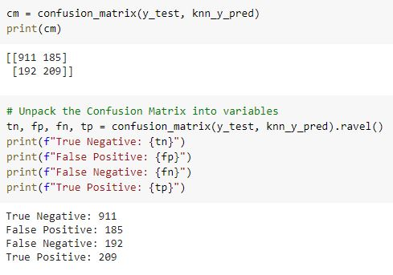
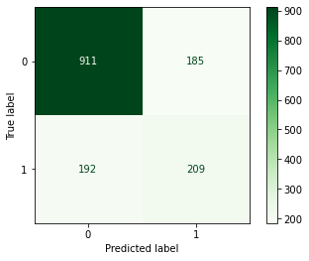
K-Nearest Neighbor Results (Confusion Matrix)

Slide 17
Conclusion
We trained and tested three different models using three different classification algorithms: The Random Forest Algorithm, The Logistic Regression Algorithm, The K-Nearest Neighbor Algorithm.
We obtained same results from Random Forest & Logistic Regression Algorithms at 73% accuracy.
We obtained a slightly better performance with the K-Nearest Neighbor Model at 74%

Slide 18
Questions

